Slide 1
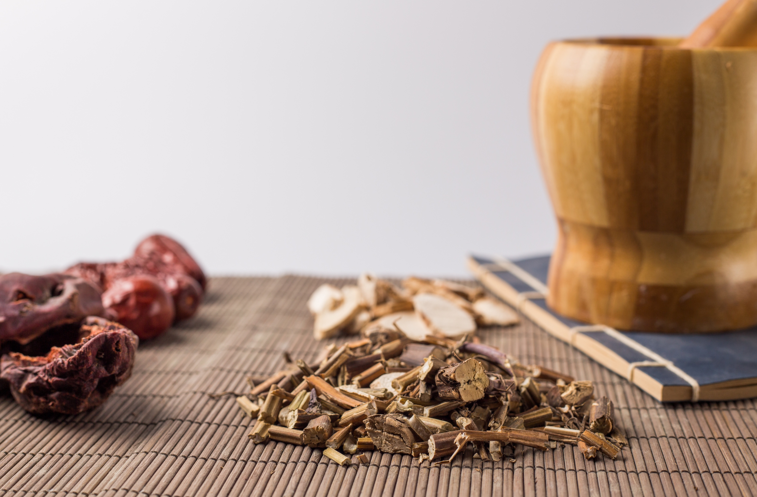
Benefits of Traditional Chinese Medicine
LECTURE 2
Shawna Williams-499 Capstone Dr. Jericho Leftwich

Slide 2

Welcome!
Benefits of Traditional Chinese Medicine is an interactive wellness lecture series introducing you to integrative medicine's power.
After this session, you will have a better grasp of Traditional Chinese Medicine for health conditions that are normally treated by Western medicine.
You will be empowered to choose your own healing path and see what works for you.
There will be a Q&A session at the end.

Slide 3
Agenda
11:30 AM
11:45 AM
12:00 PM
12:15 PM
12:30 PM
— Introductions & Ice breakers
— History of Traditional Chinese Medicine
— TCM Health Benefits
—
—Various modes and benefits
— Activity: Short Tai Chi and Qigong stretches
—
— Q&A Discussion
— Closing Remarks
TCM Health Benefits for Black Women
12:35 PM
12:50 PM
1:00 PM
1:05 PM
Break Out Session- What are some reasons that our community has not tried TCM?

Slide 4
HISTORY OF TRADITIONAL CHINESE MEDICINE
The premise of Traditional Chinese Medicine is balance and harmony
The philosophy relies on Qi (pronounced chee), which is the body’s energy
Chinese medicine has its roots in the Shang Dynasty Period (1600–1046 BC), an era characterized by shamanistic practices.
Shang Di was a religious deity believed to be in the company of ancestral spirits residing in a heavenly imperial court.
Like many ancient civilizations, they believed that sicknesses originated from offending a deity or a curse
TCM is a medical system that encourages physical, spiritual, and emotional balance
Notes:
Traditional Chinese Medicine goal is to restore the bodies balance. (National Institute of Cancer, n.d.) Four thousands of years it has been used to prevent, diagnose and treat diseases within the body. The goal of TCM is to get down to roots of the sickness or disease. (Gaur, R., 2024)

Slide 5
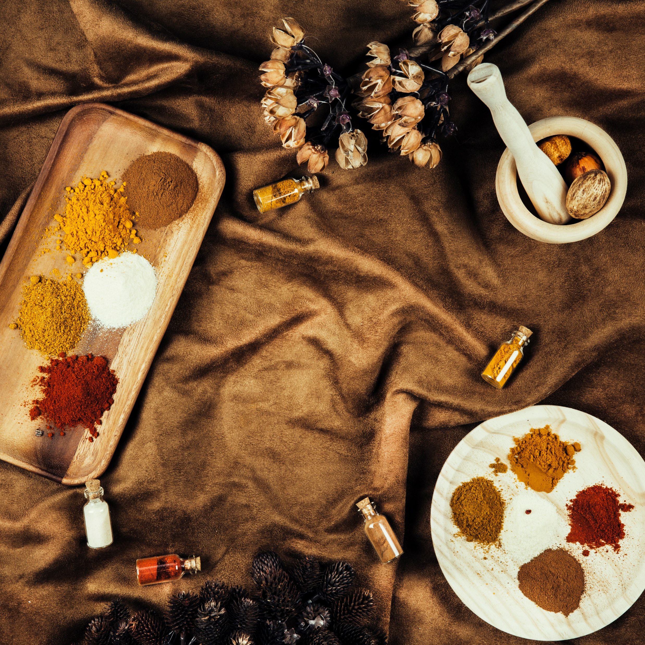
HISTORY OF TRADITIONAL CHINESE MEDICINE (continued)
Traditional Chinese Medicine practitioners were philosophers. That’s one way they differ from Western medicine practitioners.
It’s also founded upon principles of harmony and balance.
The TCM practitioner is also seen as an advisor in your wellness journey, not an authoritarian, as we’ve seen in some Western Healthcare settings.
Notes:
TCM practitioners strongly believe in working with the patient to achieve balance. They ask fewer symptom questions and dive deeper to get to the root cause of the disease. (Bruno, 2015). The practice believes in yin-yang balance and harnessing energy to flow through the proper meridians of the body.

Slide 6
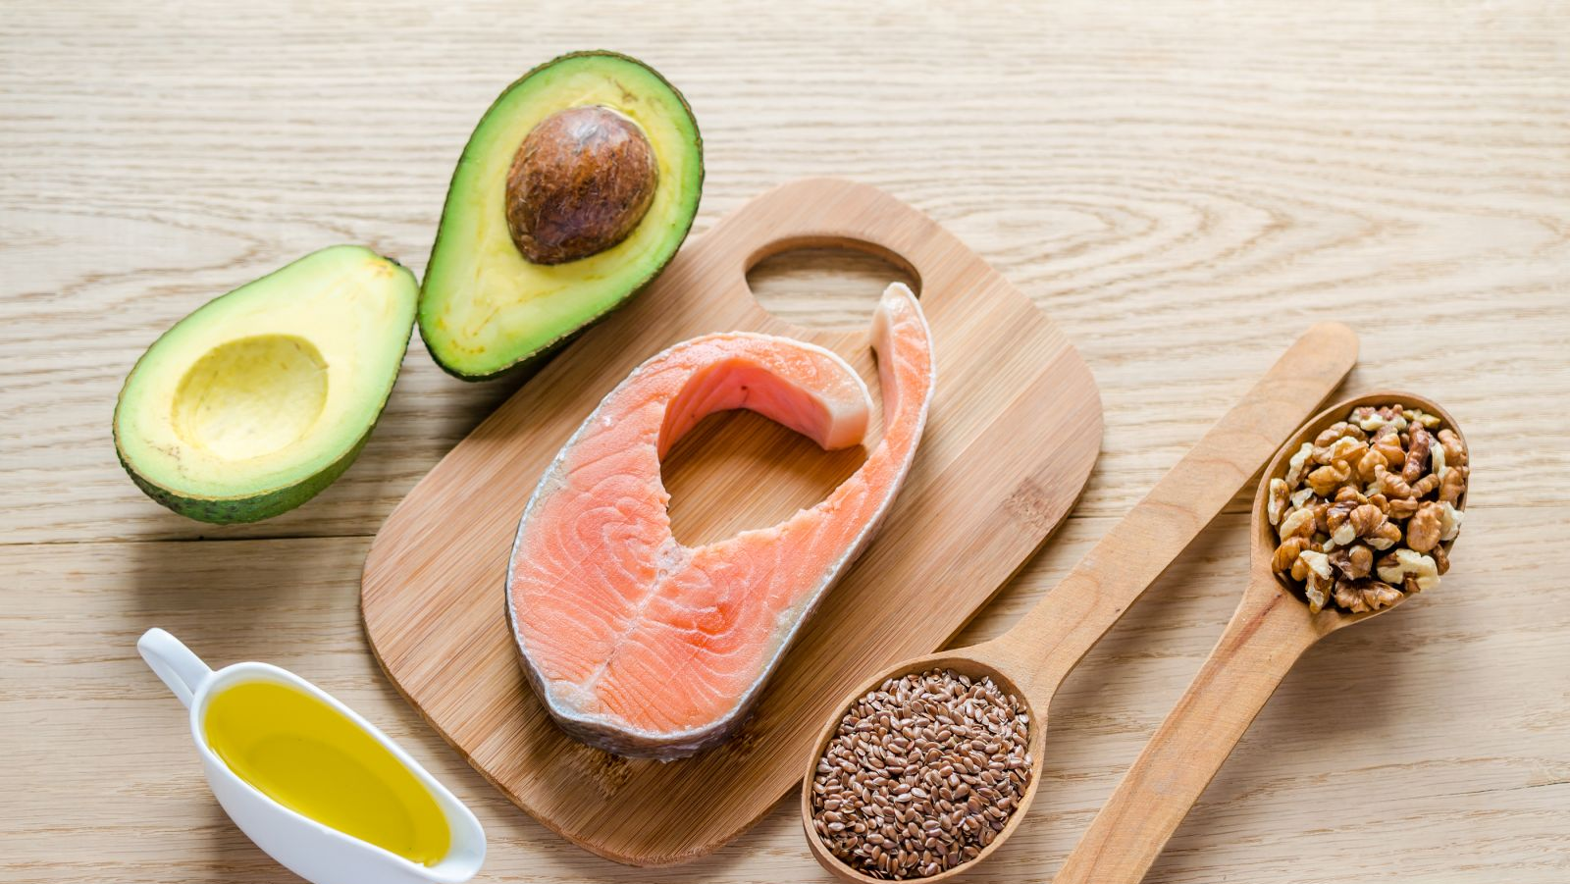
TCM HEALTH BENEFITS
TCM, such as acupuncture, can reduce pain
Can increase fertility
Has the ability to lower blood pressure
Creates hormonal balance
Can reduce PMS symptoms
Can lower anxiety
Boosts recovery for chemotherapy patients
Handout #1
Notes:
A list of benefits also includes allergy help, Parkinson's disease and fighting Alzheimer’s disease. (Mount Sinai.org, n.d)

Slide 7

TCM HEALTH BENEFITS BLACK WOMEN
Helps with Obesity
Diabetes and its complications, such as retinopathy (damage to the retina located in the back of the eye)
High cholesterol
Depression
Anxiety
Heart disease
Handout #2
Notes:
A list of benefits also includes allergy help, Parkinson's disease and fighting Alzheimer’s disease. (Mount Sinai.org, n.d)

Slide 8

TCM MODALITIES
TCM consists of diet, nutrition, spiritual exercises, and herbs.
Diet attempts to balance the yin-yang within the body with hot and warm foods.
Acupoints are known as Tuina massage.
Acupuncture, moxibustion, and Tuina massage are important to TCM. This can help alleviate pain within the body.
There are several herbs: ginseng to promote memory, ginger which reduces inflammation, and Goji berries which promote fertility.
Tai Chi and Qigong are way of exercise that promotes low-impact movement.
Handout #3

Slide 9

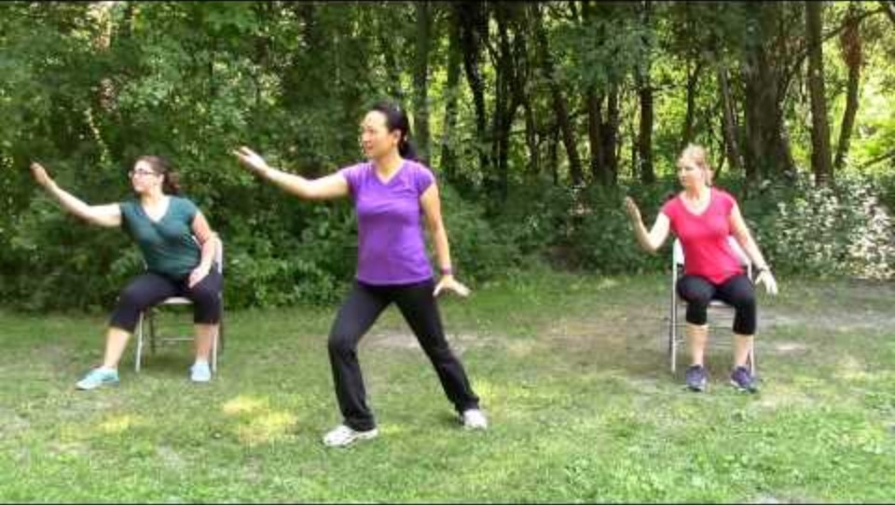
ACTIVITY: LET’S PRACTICE (15 minutes)

Slide 10

LET’S TALK!
Break Out Session- What are some reasons our community has not tried TCM or may be resistant to it?

Slide 11

QUESTIONS

Slide 12
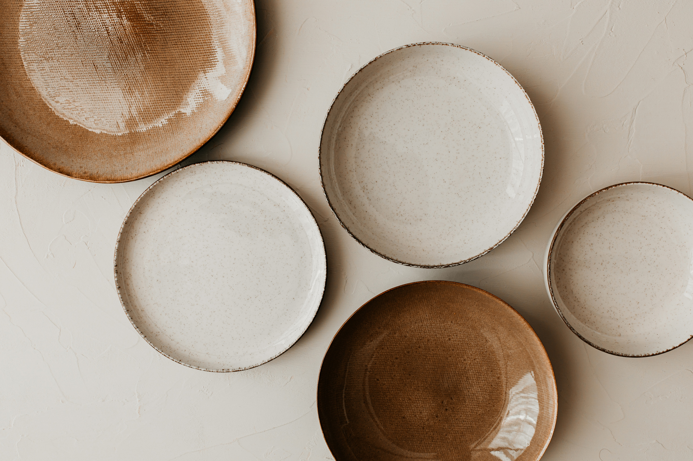
CLOSING REMARKS

Slide 13
References
National Institute of Cancer (n.d.) Traditional Chinese Medicine. Cancer.gov https://www.cancer.gov/publications/dictionaries/cancer-terms/def/traditional-chinese-medicine
Gaur, R (2024 March1) A brief history: traditional chinese medicinal system. Pharmacological Research-Modern Chinese Medicine. https://www.sciencedirect.com/science/article/pii/S2667142524000320
Bruno, L. (2015). Traditional chinese medicine In J. L. Longe (Ed.), The Gale encyclopedia of medicine (5th ed., Vol. 8, pp. 5091–5093). Farmington Hills, MI: Gale. Retrieved from https://link.gale.com/apps/doc/CX3623301863/GVRL?u=chic13451&sid=bookmark-GVRL&xid=2c556a2c
Mt. Sinai (n.d.)Traditional chinese medicine. what is traditional chinese medicine? Mt Sinai.org
https://www.mountsinai.org/health-library/treatment/traditional-chinese-medicine

